Slide 1







Advanced Time Series Analysis
Paolo Rinaldi – 12/12/2025
About two S&P500 stocks:

Slide 2
Time series and source of data
Time series: daily prices (at close), from 01/01/2015 to 31/10/2025
Number of observations: 2.724
Source of data: downloaded from investing.com, the format is .csv data
Why these two stocks? In order to highlight potential price-based relationships between one of the most sustainable (NEE, representing the renewable energy sector), and one of the most polluting (XOM, representing the oil&gas sector) companies listed on S&P500.
Why this specific time arc? I decided to start from 2015 because it is the year from which many sustainable-finance policies took part in the USA, such as the incentive to introduce sustainable stocks (considering ESG factors) in widely used pension funds, the signing of the Paris Agreement and the creation of the Task Force on Climate-related Financial Disclosures.
Why daily prices? At first I used weekly prices, as suggested by Professor Croux when asked. But then, in order to have a conspicuous number of observations within this time arc to work on the variance, I necessarily had to switch and use daily prices.

Slide 3

Univariate analysis on NEE:
Identification and Estimation
The price series (Yt) exhibits a clear stochastic trend (we do not reject the null hypothesis of a unit root), confirming that prices follow a random walk.
First differencing (∆Yt, the returns) is sufficient to achieve stationarity (the price series is integrated of order one, I(1)), allowing for ARMA and GARCH modeling.
The validity of this transformation is confirmed by the highly significant test statistic (t = -53.83).
Transformed variable | Test | Test Statistic | P-value | Conclusion
Log-Prices (Yt) | ADF (with trend) | -2.07 | 0.56 | Non-stationary (Unit Root)
Log-Returns (∆Yt) | ADF (with drift) | -53.83 | < 0.01 | Stationary, I(0)

Slide 4
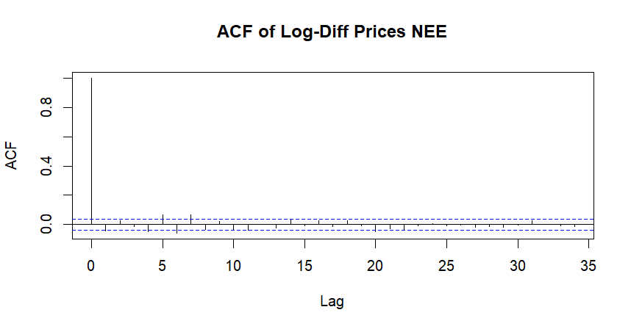
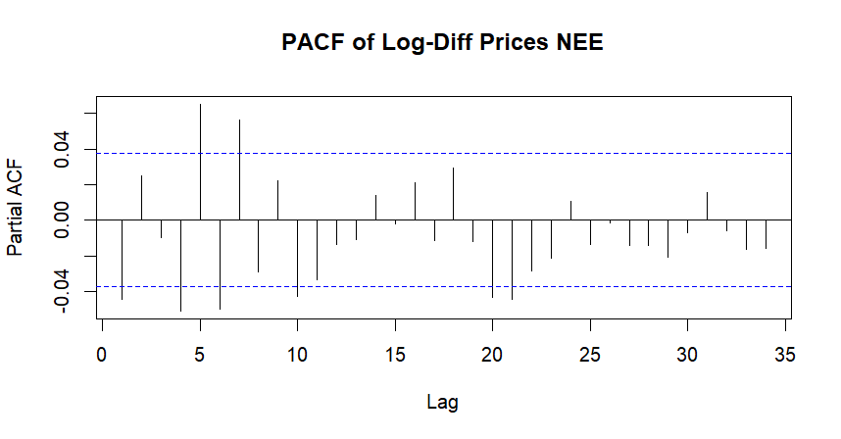
Univariate analysis on NEE:
Model Identification
From ACF, PACF we observe serial dependence at Lag 1.
A note on seasonality: from ACF, PACF we notice significant correlations also at lags 4,5,6,7. However, given the financial nature of the series and to preserve parsimony, I choose not to include seasonal components. I considered it a priority to model the strong conditional heteroscedasticity, which usually is a dominant feature of daily stock returns.

Slide 5
Univariate analysis on NEE:
Model Identification
AIC and Log-likelihood values are extremely close across models. We can interpret this pattern as a response to Efficient Market Hypothesis: the predictable component, the signal, of returns is very weak compared to the noise, for each of these simple models.
Any of these pure models passes the validity test (Ljung-Box p-value < 0.01). This indicates that the linear structure alone is insufficient to capture the data complexity.
Despite Arima(1,1,0) having a slightly better performance than Arima(1,1,1), I chosed the second one to continue the analysis because of enhanced flexibility. Suddenly, I transformed Arima(1,1,1) in Arma(1,1) in order to mix it with GARCH.
Conclusion: we need a more flexible specification!
Candidate model | Log-likelihood | AIC | P-value (Ljung-Box) | Conclusion
ARIMA(1,1,0) | 7457.79 | -14911.58 | < 0.01 | A linear specification alone is not enough, for all models
ARIMA(0,1,1) | 7457.66 | -14911.32 | < 0.01
ARIMA(1,1,1) | 7458.32 | -14910.63 | < 0.01

Slide 6
Univariate analysis on NEE:
Model Estimation
The Ljung-Box Test revealed strong autocorrelation in the squared residuals. This pattern clearly indicates financial volatility. The assumption of constant variance in classical ARIMA models is violated: a GARCH model is necessary to model this time-varying variance (conditional heteroscedasticity) and obtain more reliable estimates.
Unlike pure ARIMA models, the ARMA(1,1)+GARCH(1,1) combination yields all significant parameters. Moreover, the high value of beta1 (0.905) indicates that volatility shocks are highly persistent, while alpha1 (0.085) shows that new market shocks have an immediate impact, even though smaller than the effects of recent volatility.
Test | Variable | Null Hypothesis H0 | P-value | Conclusion
Ljung-Box (R^2) | Squared ARIMA residuals | No ARCH effects | < 2.2 e^-16 | Strong presence of ARCH effects
Parameter | Estimate | P-value
mu | 0.0005 | 0.012
ar1 | 0.358 | 0.024
ma1 | -0.404 | 0.010
alpha1 | 0.085 | 0.022
beta1 | 0.905 | < 2 e^-16

Slide 7
Univariate analysis on NEE:
Model Validation
The GARCH model successfully “cleaned” the data: there is no remaining autocorrelation in the mean (R), nor the variance (R^2): mean and variance effects have being captured.
This formally validates the model for forecasting, and provides additional information also in terms of risk modelling: a risk-averse investor would benefit from a forecast that includes information on the variance of the financial product he/she is investing in.
Anyway, since we are focusing on forecasting the expected mean returns, we cannot ensure that this additional information about volatility is going to add precision to our forecast.
Test on | Null Hypothesis H0 | Tested Lag | P-value | Conclusions
Stdz residuals (R) | No autocorrelation | 15 | 0.27 | No serial autocorrelation left in stdz residuals
Squared stdz residuals (R^2) | No ARCH effects | 15 | 0.59 | No ARCH effects left in squared residuals

Slide 8
Univariate analysis on NEE:
Forecast and conclusions
Statistically, as we could expect, the complex model (ARMA(1,1)+GARCH(1,1)) does not outperform the simple pure model (ARMA(1,1)) in predicting future mean return (p-value >0.05).
However, we can say that the true advantage of GARCH lies in the dynamic estimation of the confidence interval (given from the variance effect being captured).
This is because ARMA(1,1) model underestimates risk during crises, since it assumes homoscedasticity, while GARCH adapts to time-varying variance, offering superior protection for, as we said before, investors who want to always keep an eye on the volatility of their investment.
Metric / Test | GARCH model | ARMA model | Test Result
MAE | 0.01256 | 0.01255 | -
Diebold-Mariano Test | - | - | P-value = 0.825

Slide 9

Multivariate analysis on NEE, XOM
Cointegration test (Johansen)
There is no statistical evidence of a long-run equilibrium relationship between Exxon Mobil and NextEra Energy stock prices. The two companies, despite operating in the same sector following diametrically opposed business models, follow independent stochastic trends.
This result rules out the use of a Vector Error Correction Modell (VECM), and suggests analysing short-term interactions via a Vector Autoregressive Model (VAR) on returns.
Null Hypothesis H0 | Alternative | Test Statistic | Critical Value (5%) | Result | Conclusion
r = 0 | r > 0 | 7.88 | 19.96 | Don’t reject H0 | The two series are not cointegrated
r <= 1 | r >1 | 2.74 | 9.24 | Don’t reject H0

Slide 10
Multivariate analysis on NEE, XOM
VAR and conclusions on Granger Causality
From the VAR model a clear informational asymmetry emerges. Past movements of NextEra Energy (renewable leader) negatively predict Exxon Mobil (oil&gas leader) returns, but not vice versa
(i.e. NEE Granger-causes XOM, but not vice versa).
We can give an economic, financial interpretation to this result:
The negative sign (-0.074) on XOM return’s coefficient suggests a portfolio rebalancing effect: when the green sector (NEE) performs well, investors tend to sell or underweight the traditional sector (XOM) the following day. Crucially, this does not hold in reverse: strong performance in fossil fuels (XOM) seems to not trigger a significant sell-off in renewables (NEE), highlighting the resilience and stickiness of green asset allocations in investor portfolios.
Dependent Variable (Today) | Explanatory Variable (Yesterday, Lag 1) | Coefficient | P-value | Conclusions
XOM return | NEE return | -0.074 | -0.0007 * | Significant causality
NEE return | XOM return | -0.024 | 0.161 (n.s.) | No significant causality

Slide 11

Thank you
Paolo Rinaldi

